Slide 1
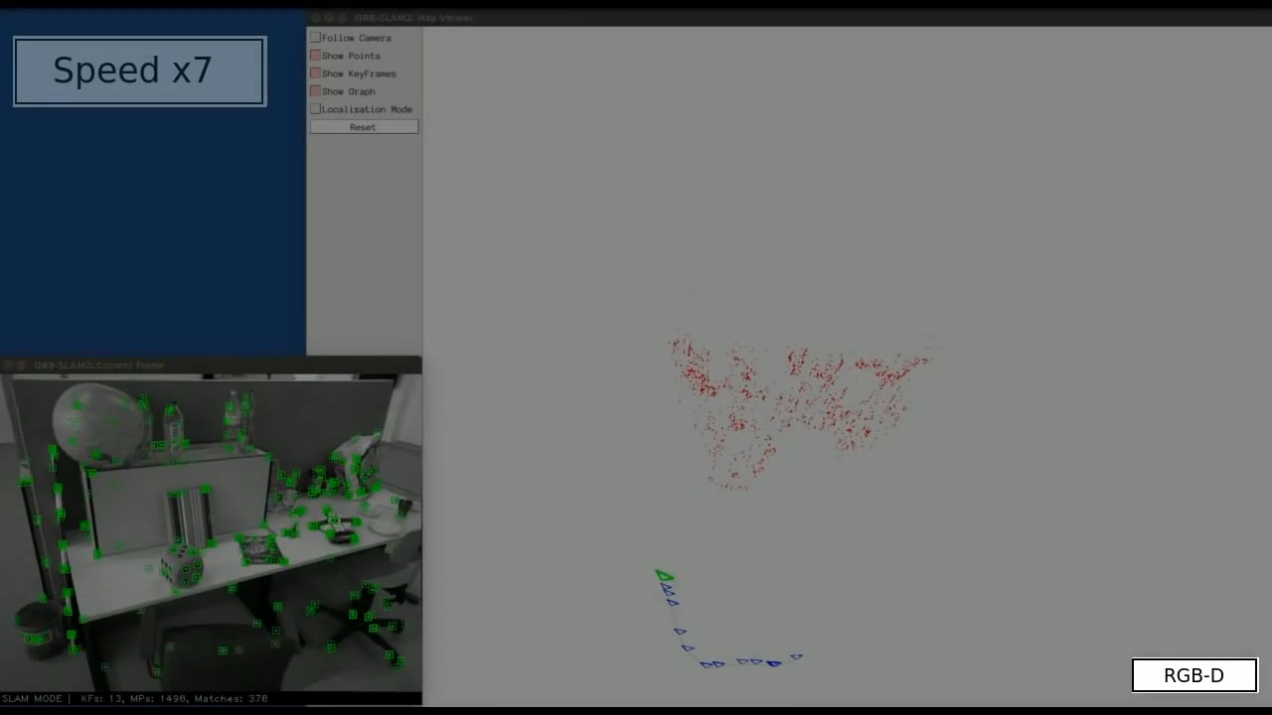
SLAM:
Simultaneous Localization and Mapping
* Huge amounts of data
* Operate online

Slide 2
Where to begin? How do we even approach such a problem?
Draw the problem model on the board
Write a mathematical equation describing the problem
Optimize

Slide 3
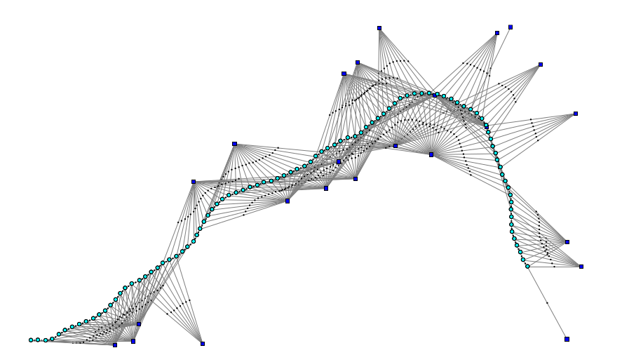
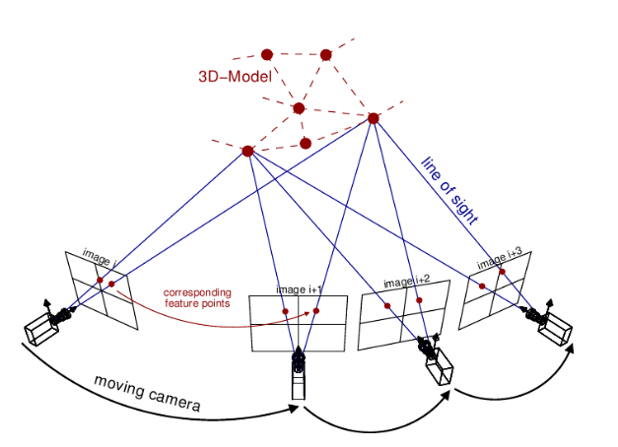
Draw the problem model on the board
Write a mathematical equation describing the problem
Optimize
Landmarks
Landmarks
Camera

Slide 4
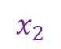
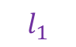
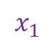
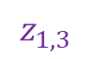
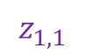
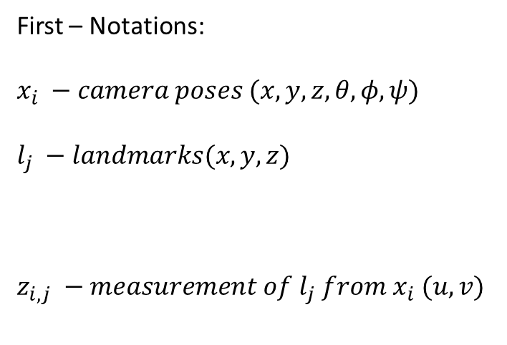
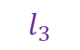
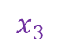
Draw the problem model on the board
Write a mathematical equation describing the problem
Optimize
We want to know
$$l_{3}$$
First – Notations:
$$x_{i} −camera poses (x,y,z,θ,φ,ψ)$$
$$l_{j} −landmarks(x,y,z)$$
$$z_{i,j} −measurement of l_{j} from x_{i} (u,v)$$
$$l_{1}$$
$$z_{1,1}$$
Given
$$x_{1}$$
$$x_{3}$$
$$x_{2}$$
$$z_{1,3}$$

Slide 5


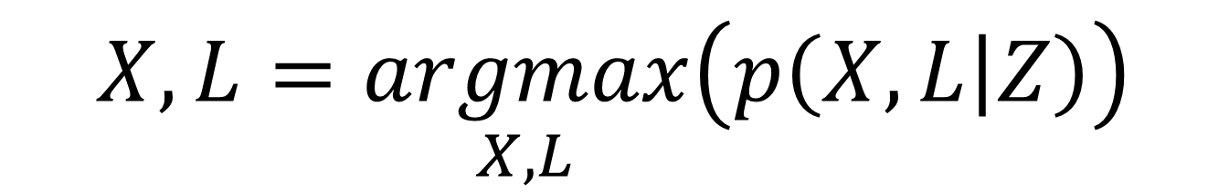
Draw the problem model on the board
Write a mathematical equation describing the problem
Optimize
The Probability of getting poses $X$ and landmarks $L$, given all measurements $Z$
$$p\left(X, L | Z\right)$$
We want to choose $X$ and $L$ that will maximize this probability
$$X,L=\underset{X,L}{argmax}\left(p\left(X, L | Z\right)\right)$$

Slide 6
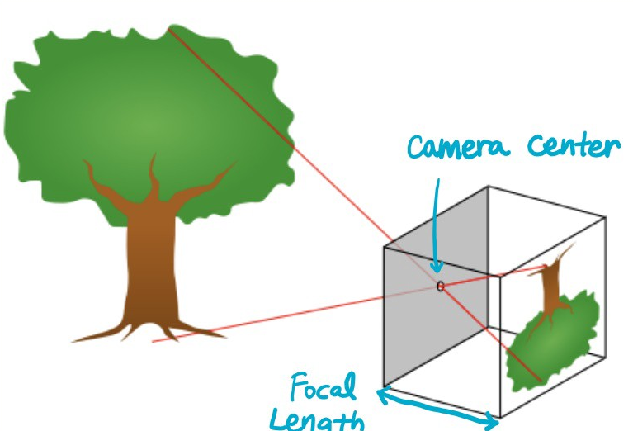
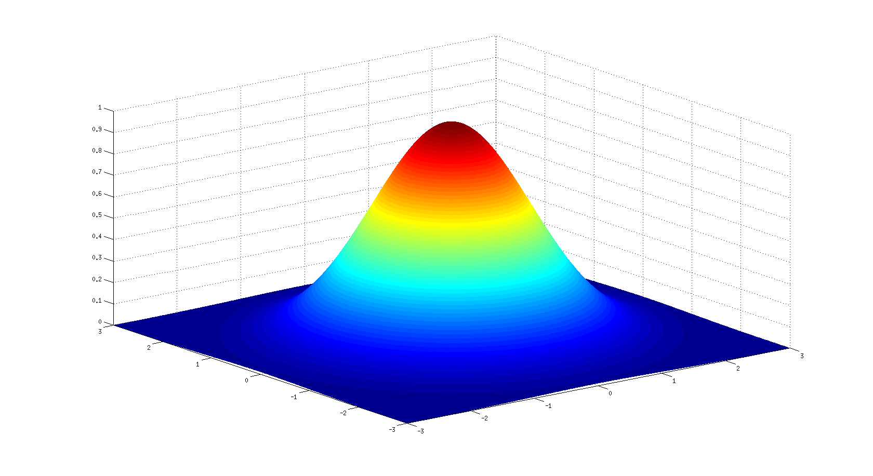
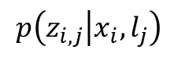
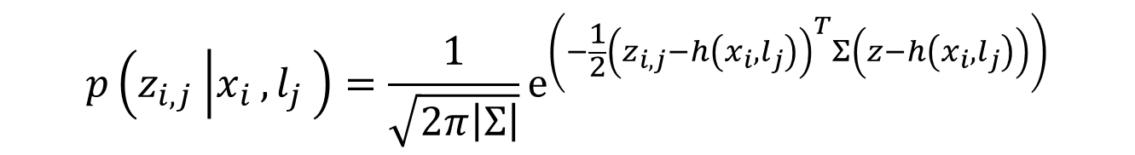
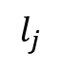
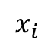
Draw the problem model on the board
Write a mathematical equation describing the problem
Optimize
Camera Model
Gaussian Distribution
Camera Model: Given known pose and landmark, we should know which pixels were “hit”
$$p\left(z_{i,j} | x_{i},l_{j}\right)$$
$$x_{i}$$
$$l_{j}$$
$$p\left({z_{i,j}}_{ } | {x_{i}}_{ },{l_{j}}_{ }\right)=\frac{1}{\sqrt{2π\left|Σ\right|}}e^{\left(−\frac{1}{2}{\left(z_{i,j}−h\left(x_{i},l_{j}\right)\right)}^{T}Σ\left(z−h\left(x_{i},l_{j}\right)\right)\right)}$$

Slide 7


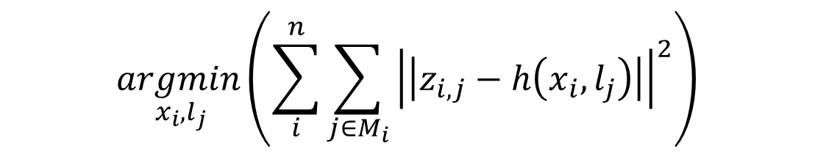
Draw the problem model on the board
Write a mathematical equation describing the problem
Optimize
$$p\left({z_{i,j}}_{ } | {x_{i}}_{ },{l_{j}}_{ }\right)=\frac{1}{\sqrt{2π\left|Σ\right|}}e^{\left(−\frac{1}{2}{\left(z_{i,j}−h\left(x_{i},l_{j}\right)\right)}^{T}Σ\left(z−h\left(x_{i},l_{j}\right)\right)\right)}$$
+ Bayes rule
+ Covariance consistent for all measurements
$$\underset{ x_{i},l_{j}}{argmin}\left(\sum_{i}^{n}{\sum_{j∈M_{i}}{{\left|\left|z_{i,j}−h\left(x_{i},l_{j}\right)\right|\right|}^{2}}}\right)$$
$$X^{∗},L^{∗}=\underset{X^{ },L}{argmax}\left(p\left(X, L | Z\right)\right)=$$

Slide 8
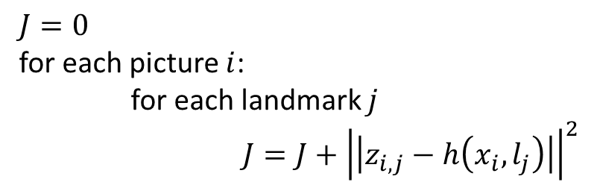
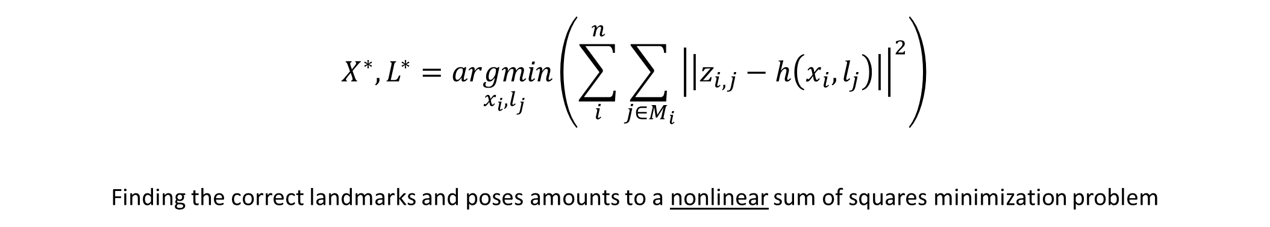
Draw the problem model on the board
Write a mathematical equation describing the problem
Optimize
$$X^{∗},L^{∗}=\underset{ x_{i},l_{j}}{argmin}\left(\sum_{i}^{n}{\sum_{j∈M_{i}}{{\left|\left|z_{i,j}−h\left(x_{i},l_{j}\right)\right|\right|}^{2}}}\right)$$
Finding the correct landmarks and poses amounts to a nonlinear sum of squares minimization problem
$$J=0$$
for each picture $i$:
for each landmark $j$
$J=J+{\left|\left|z_{i,j}−h\left(x_{i},l_{j}\right)\right|\right|}^{2}$

Slide 9

Draw the problem model on the board
Write a mathematical equation describing the model
Optimize
$$X^{∗},L^{∗}=\underset{ x_{i},l_{j}}{argmin}\left(\sum_{i}^{n}{\sum_{j∈M_{i}}{{\left|\left|z_{i,j}−h\left(x_{i},l_{j}\right)\right|\right|}^{2}}}\right)$$

